Slide 1

Introduction to Microservices

Slide 2

Architectural style

Slide 3
This is not new!
The old new thing...

Slide 4

SOA
Service
Oriented
Architecture
Modernized version of SOA
New world:
Speed of delivery
Scalability
Innovation / Experimentation
Cloud / Devops

Slide 5
VS
Monolith
Microservices

Slide 6
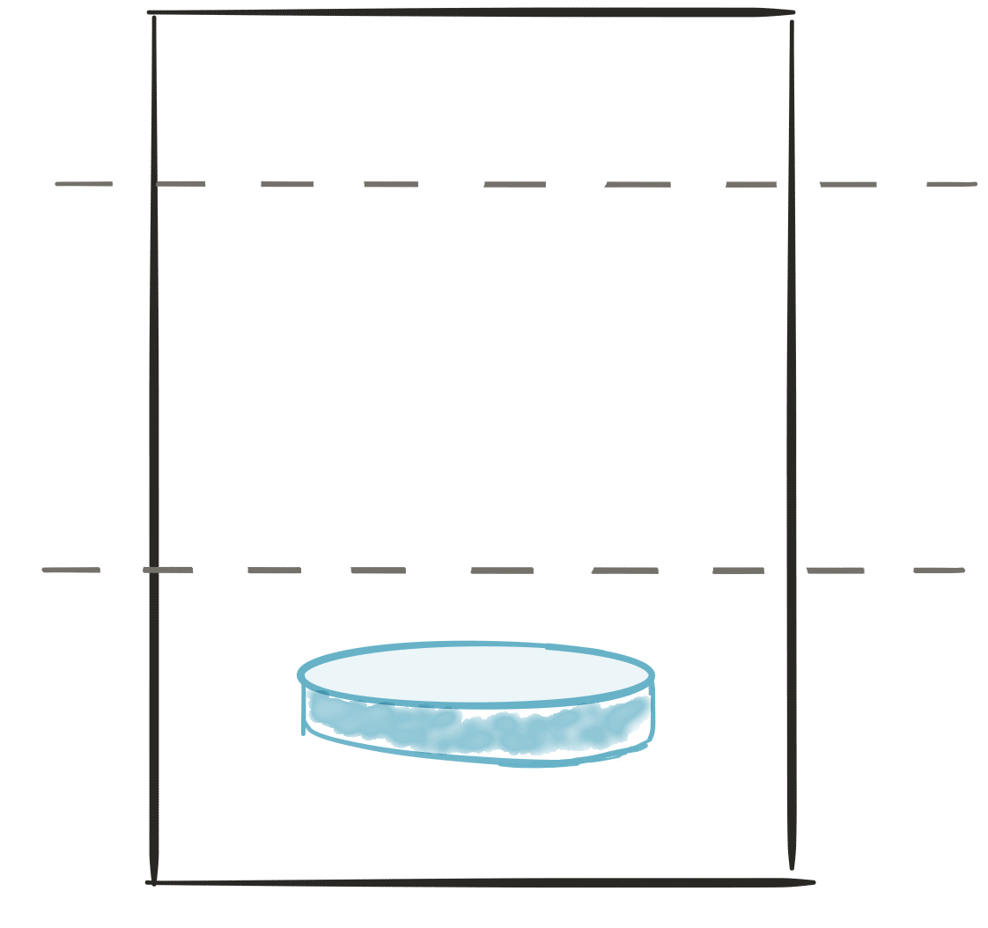
A monolith
Module
A
Module
B
Module
c
Module
D
PRESENTATION LAYER
BUSINESS LOGIC LAYER
DATABASE LAYER

Slide 7
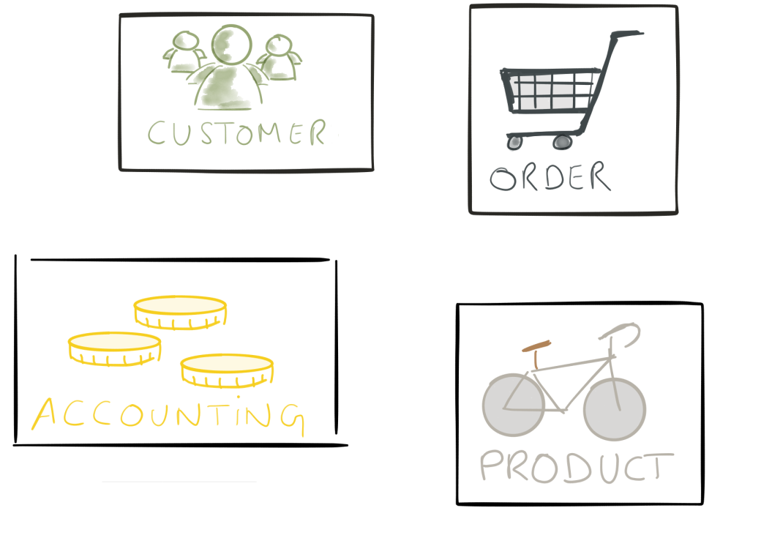
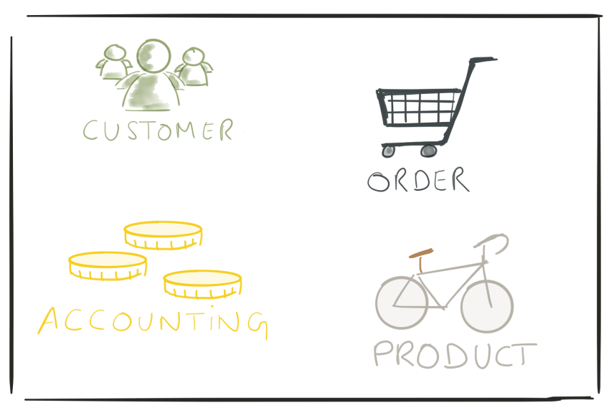
VS
Monolith
Microservices

Slide 8
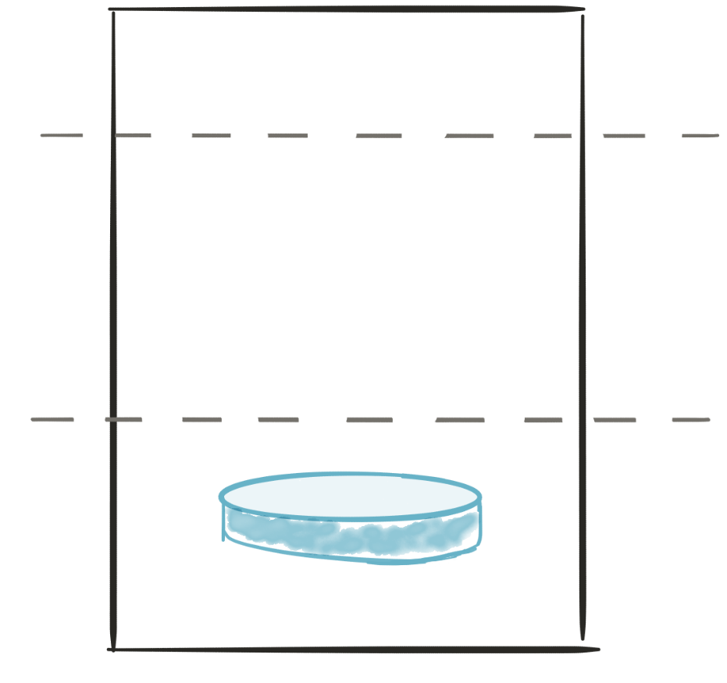
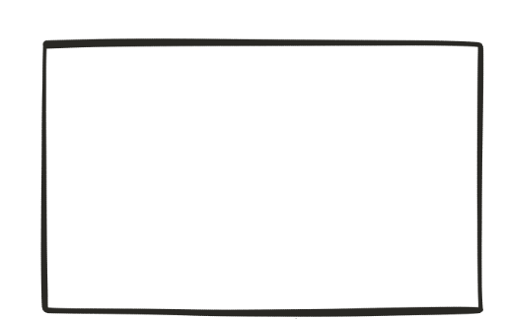
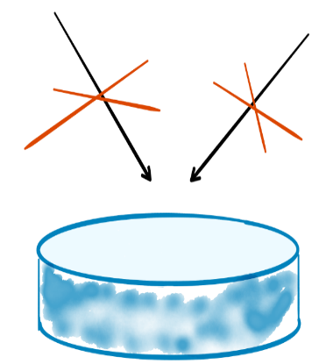
microservices
API
API
PRESENTATION LAYER
consume
Produce
BUSINESS LOGIC
LAYER
BUSINESS LOGIC LAYER
DATABASE LAYER
DATABASE LAYER
Microservice 2
Microservice 1

Slide 9
Principles
Modularity
Autonomous
Hide implementation details
Automation
Stateless
Highly observable

Slide 10
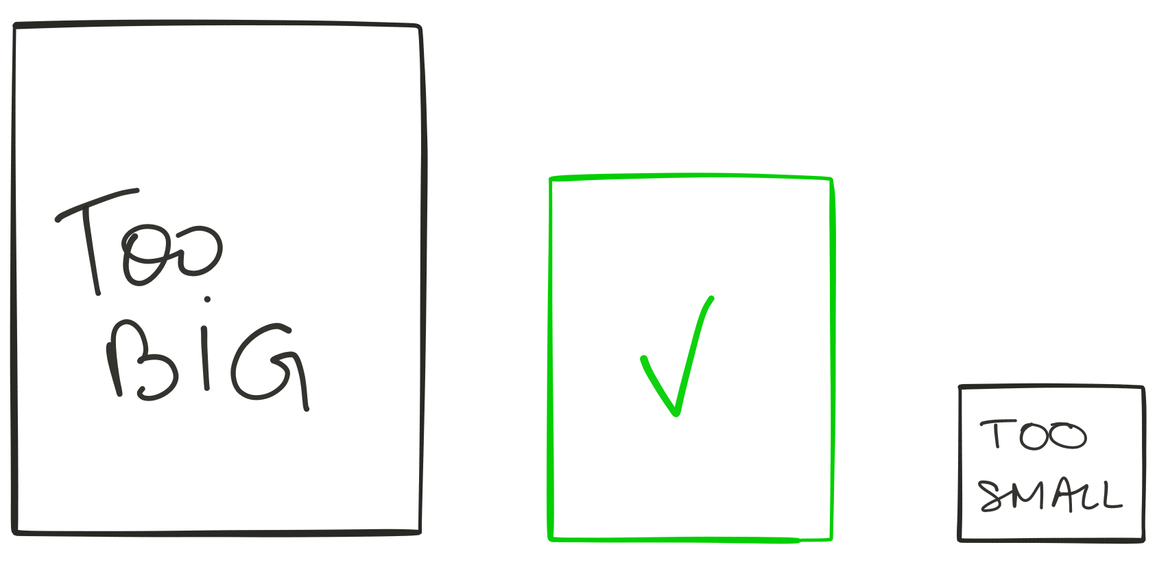
Modularity

Slide 11

Modularity
Modeled around business capability
Single responsibility
Single data domain
Separation of concerns
Low coupling
Understandable by a person

Slide 12
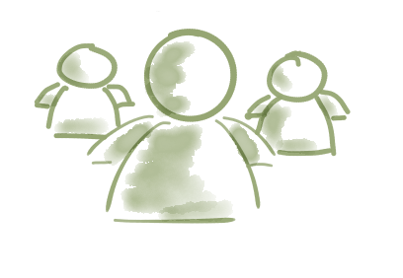
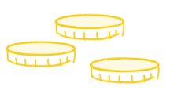

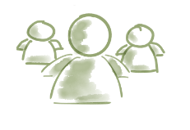


Modularity (TEAM)
A product not a project
UI - team
UI
dba
SERVER
SERVER - team
UI
dba
SERVER
Dba - team
UI
dba
SERVER
monolith
microservices

Slide 13


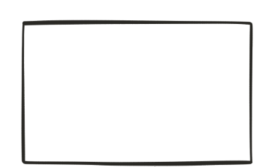
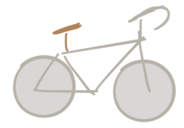
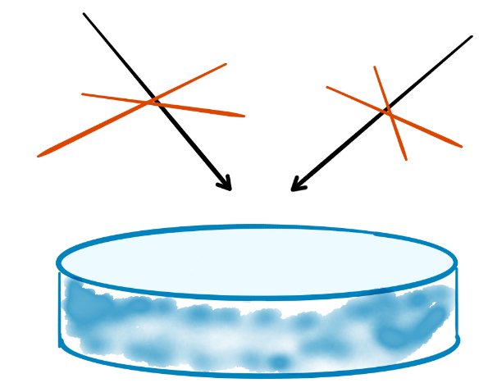
Autonomous

Slide 14
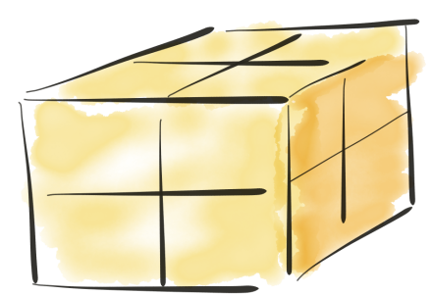
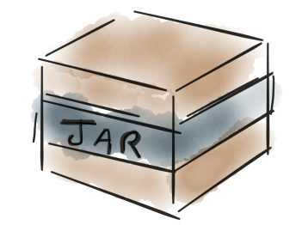



Autonomous
- Libraries
- http listener
Monolith
Microservices

Slide 15
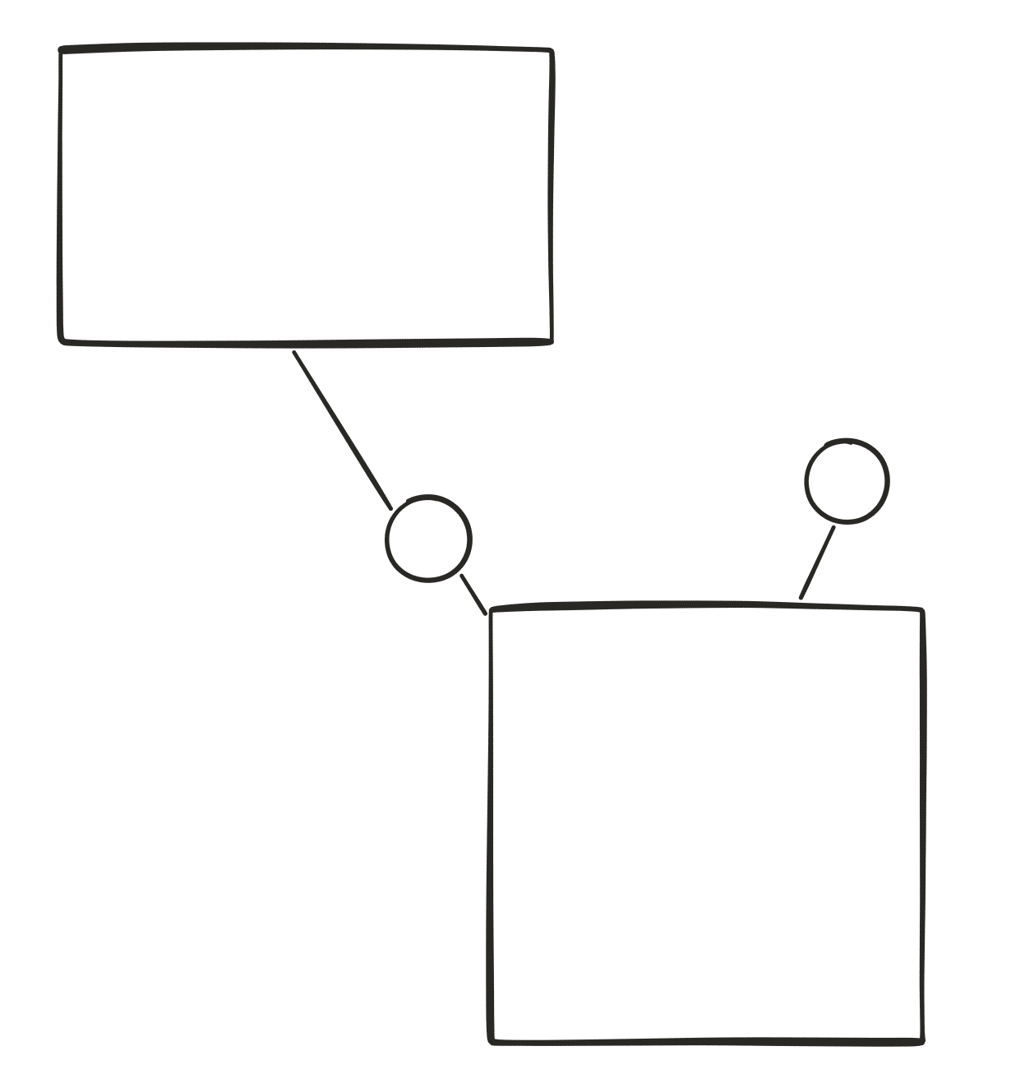

Autonomous
v2
v1

Slide 16
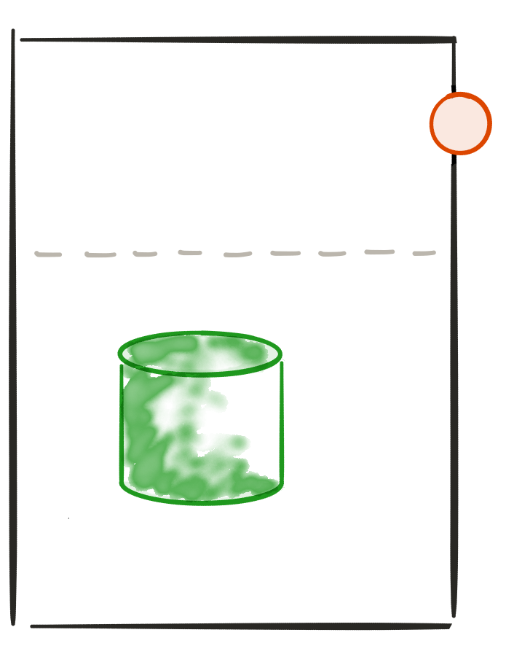
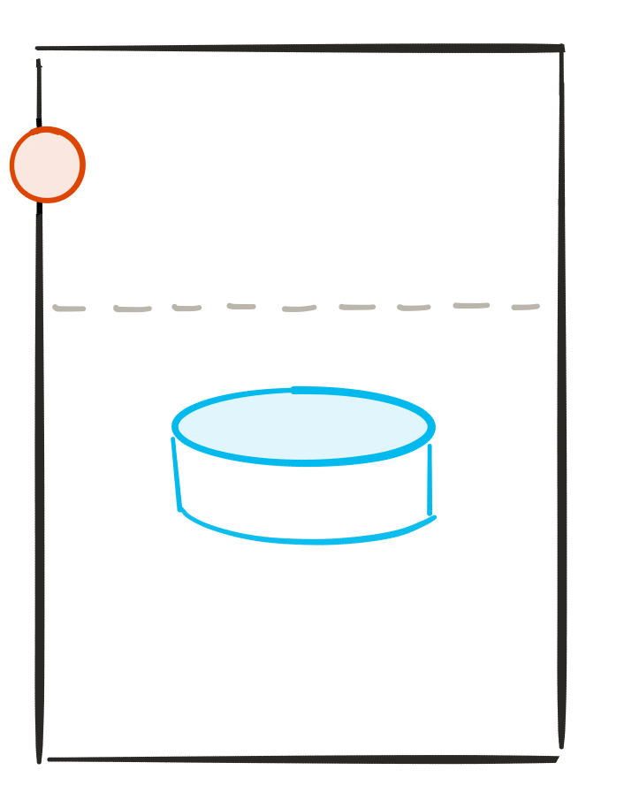






Hide implementation details
API
-http
-rest
-json
API
http-
Rest-
Json-

Slide 17

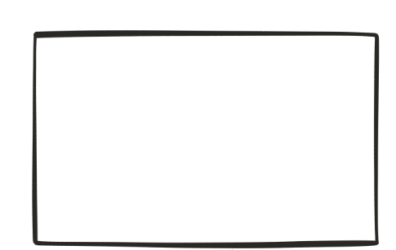
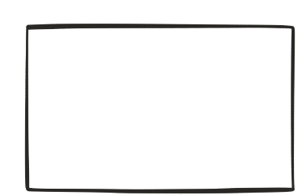

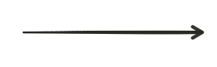
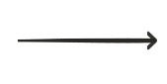
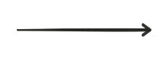
Automation
Deploy
On dev/TEST
Deploy on
prod
build
testing
Continuous Integration
Continuous Deployment

Slide 18
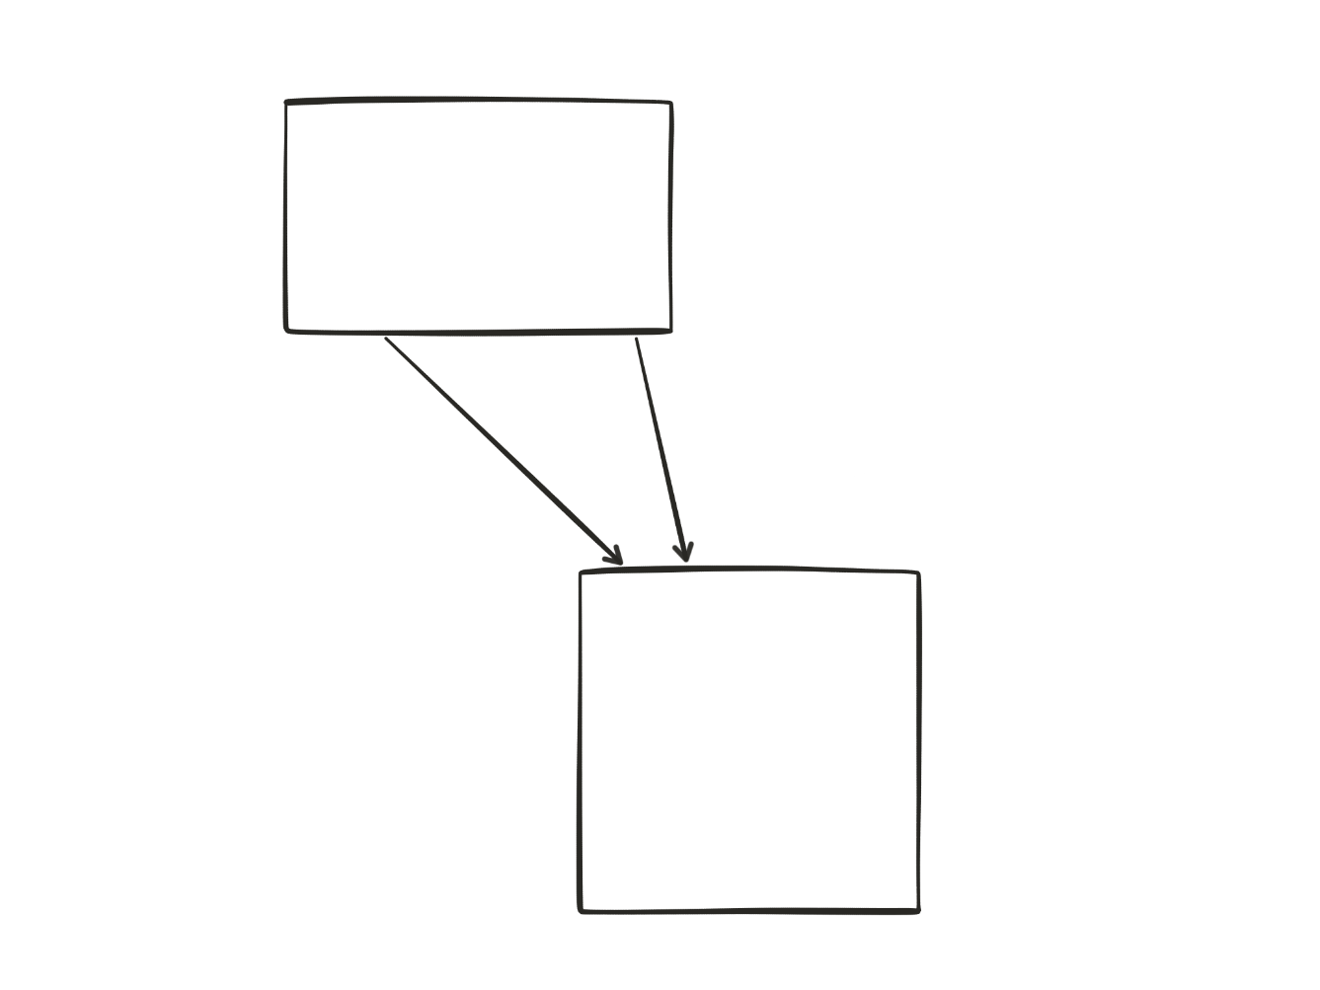
Stateless
(2)
(1)
Notes:
Easier to scale / recover from failure

Slide 19

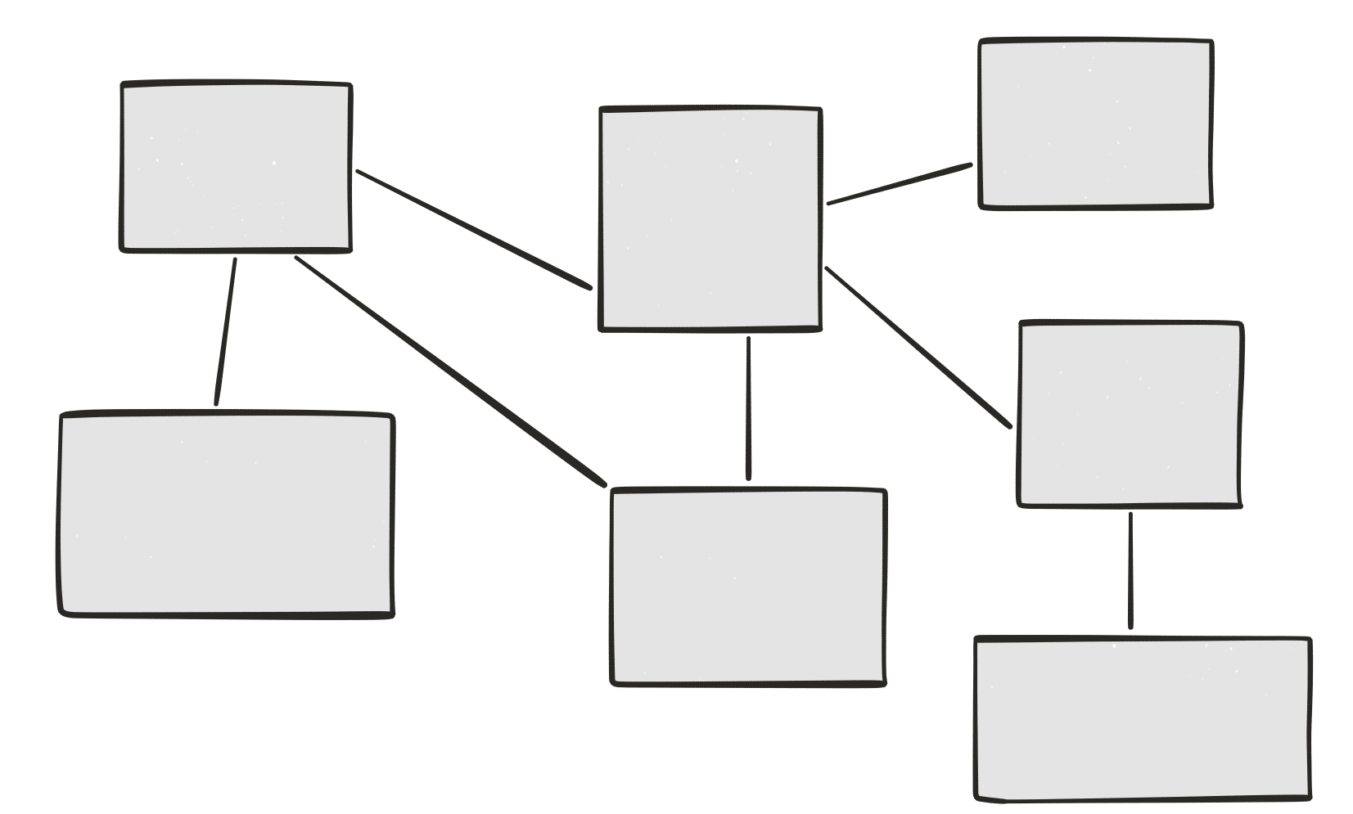
Highly observable
Logs

Slide 20
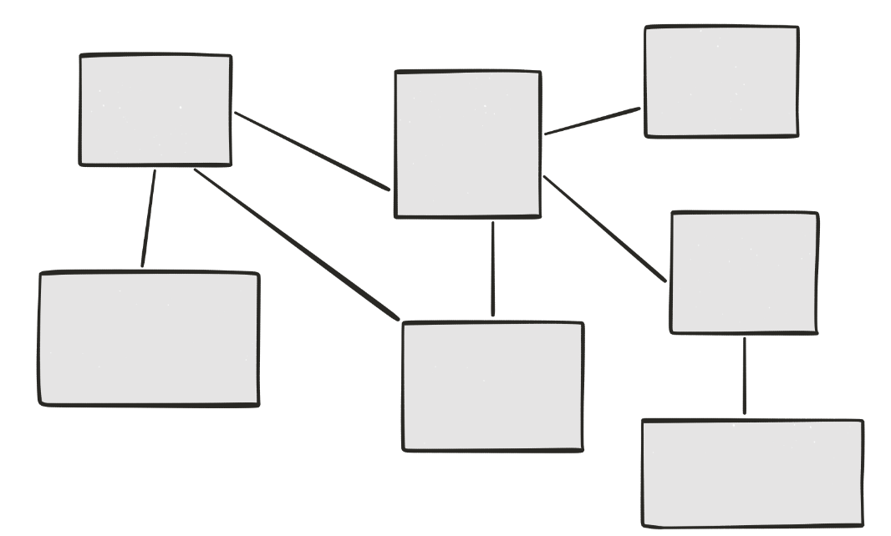

Highly observable
Centralized logging

Slide 21
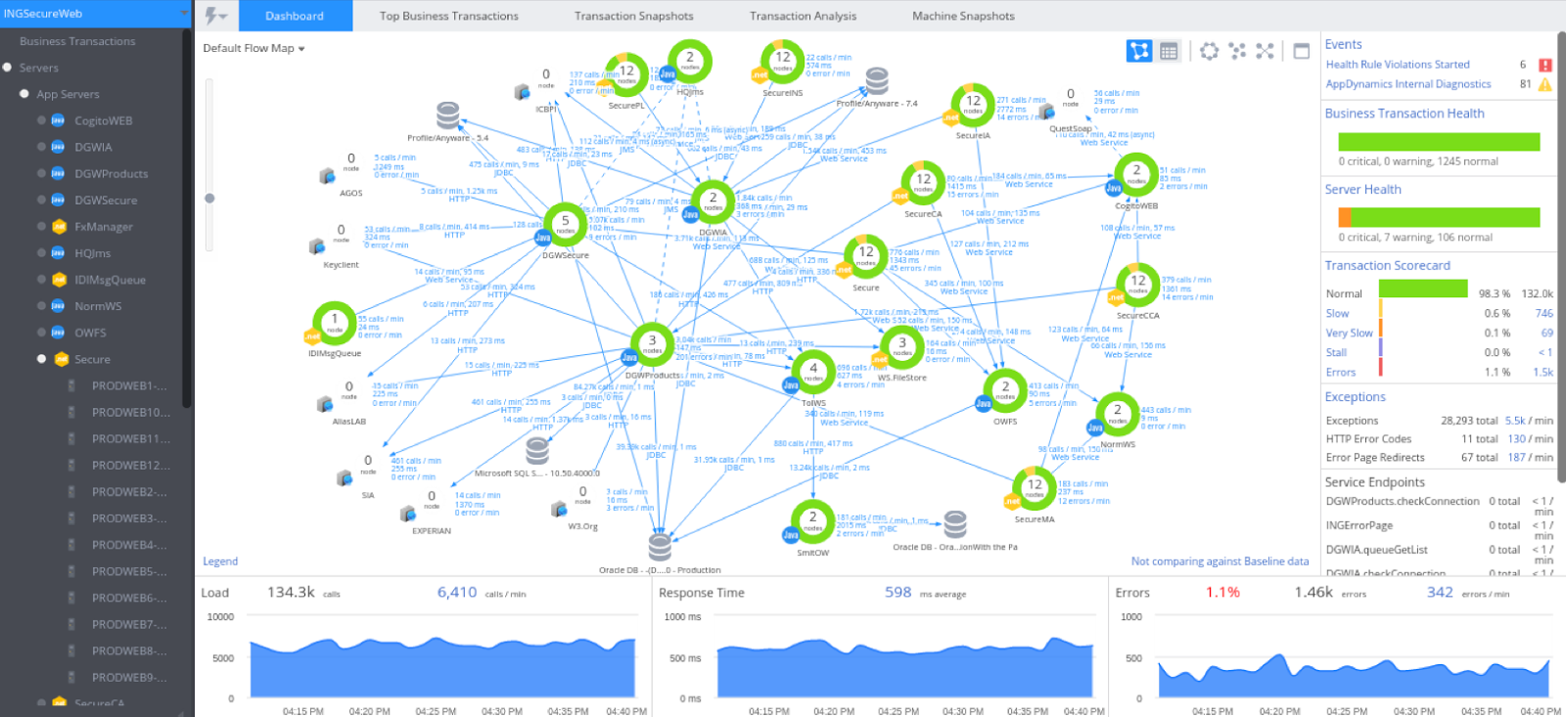
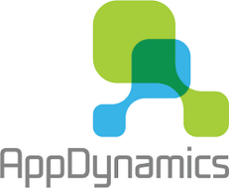
Highly observable
Monitoring

Slide 22
Highly observable
Correlation IDs
ID 5678
ID 5678
ID 5678
ID 5678

Slide 23
Principles
Modularity
Autonomous
Hide implementation details
Automation
Stateless
Highly observable

Slide 24
Advantages

Slide 25
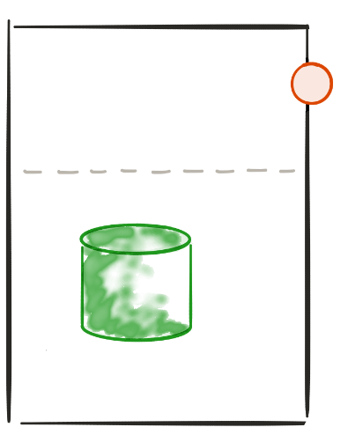
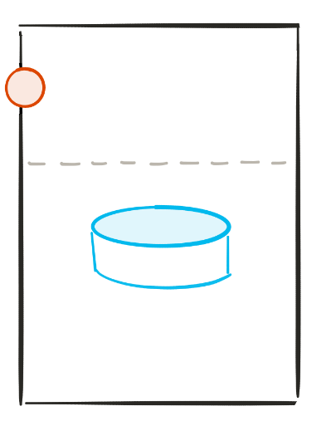


Polyglot architecture
The right technology for the job
Reduce technical debt

Slide 26
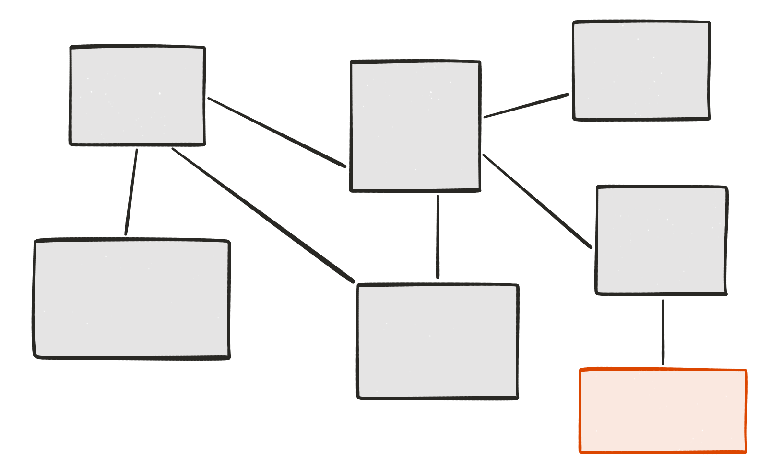
Evolutionary design
Remove
Add
Replace
Experimental microservice
Grow at “no” cost

Slide 27
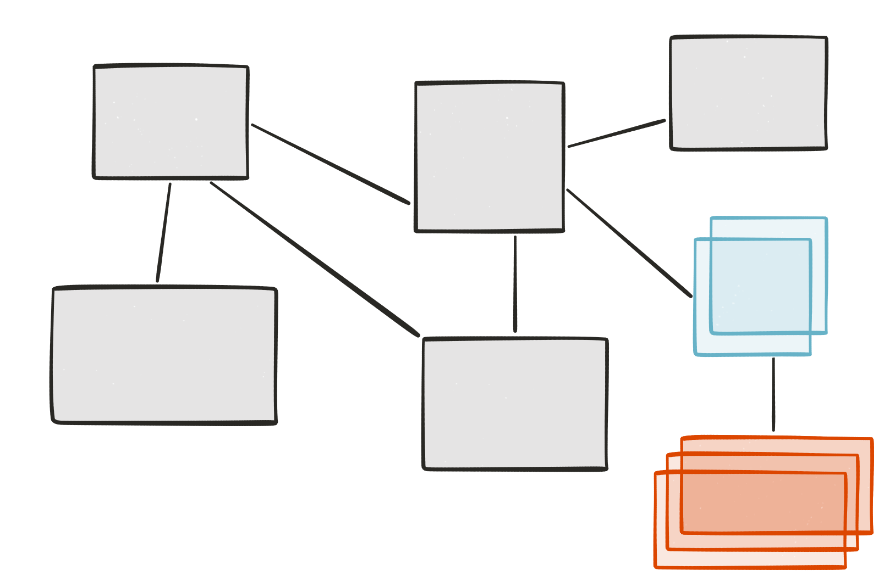
Selective scalability
Nb users > 500

Slide 28
Big vs Small
Smaller code base
Simpler to develop / test / deploy / scale
Start faster
Easier for new developers

Slide 29
Drawbacks

Slide 30
Drawbacks
Distributed system
Consistency
Transaction
Request travelling
Slow (http)
Requires an ecosystem
Synchronous vs asynchronous
Integration tests

Slide 31
Conclusion
The Microservices architecture is more complex
Than a monolith.
This the cost of growing and scaling easily

Slide 32
Microservices Ecosystem

Slide 33

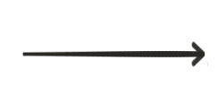

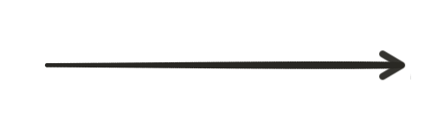
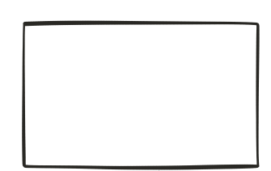
Loadbalancer
Loadbalancer

Slide 34

Loadbalancer (client side)
Load balancer

Slide 35
Service Discovery
Service discovery
server
register
register

Slide 36
Service Discovery
Service discovery
server
I want TO TALK TO THE PRODUCT SERVICE !
Here is the product service !

Slide 37
Service Discovery (load balancing)
Service discovery
server
I want TO TALK TO THE PRODUCT SERVICE !
Here is one instance of product service !

Slide 38
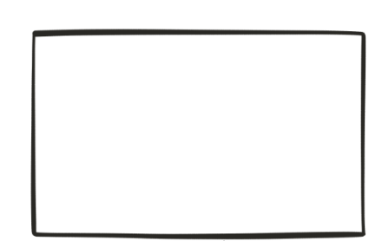

API Gateway
Browser UI
e.g. angular 2
Mobile app
API Gateway
e.G. (ZUUL)
Notes:
API gateway
Insulates the clients from how the application is partitioned into microservices
insulate the clients from the problem of determining the locations of service instances
Provides the optimal API for each client
Reduces the number of requests / roundtrips.
Backend for front end

Slide 39
This is not new!
The old new thing...
Principles
Modularity
Autonomous
hide implementation details
Automation
Stateless
highly observable
Advantages
Polyglot architecture
Evolutionary design
Selective scalability
Big vs small
Drawbacks
Distributed system
Synchronous vs asynchronous
Slow (http)
Requires an ecosystem
Ecosystem
Load balancer
Service discovery
api gateway

Slide 40
Thank You

